Slide 1
Superstore - Sales Analysis
Report generated using Python (Pandas, Seaborn, Matplotlib) by Arodi Sandoval
2024 Fiscal Year

Slide 2

Analysis Objective
The objective of this analysis is to identify the top selling products, sales peaks during the year and the areas where we have sold the most product. Based on these results, we can plan a sales strategy for the next fiscal year and optimize our inventory.

Slide 3

Dataset Description
Source: Kaggle (superstore-dataset-final).
Columns: Row ID, Order ID, Order Date, Ship Date, Ship Mode, Customer ID, Customer Name, Segment, Country, City, State, Postal Code, Region, Product ID, Category, Sub-Category, Product Name, Sale, Quantity, Discount, Profit.
Total registered: 9994 entries.

Slide 4
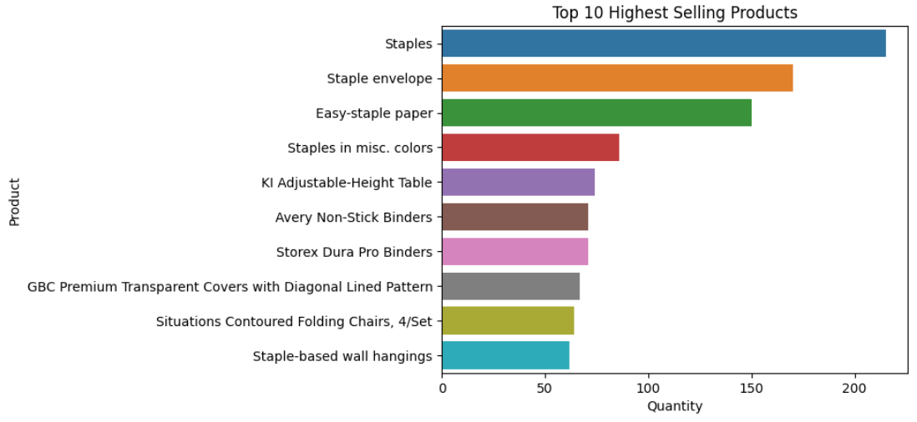
Top 10 Highest Selling Products

Slide 5


Top 10 Highest Selling Products (Insights)
Regular staples are leading the sales with more than 200 units sold this past year.
Staples in general are our most demanded products overall.
Besides staples, the adjustable height table is another highly demanded product.

Slide 6
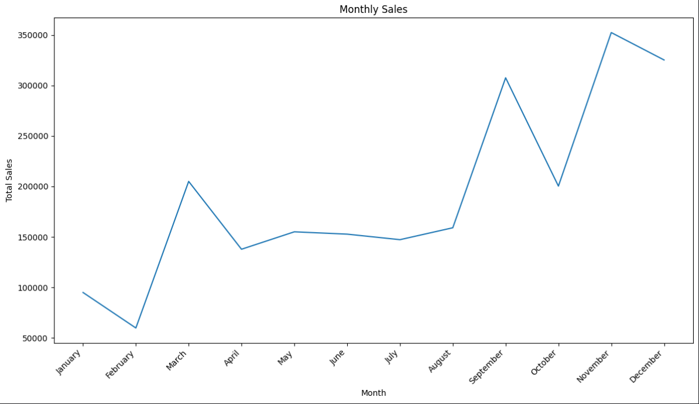
Monthly Sales

Slide 7

Monthly Sales (Insights)
We have experienced our best selling period of the year at November due to Black Friday sales.
Due to holiday season and winter’s weather, we experienced our lowest sales on January and February.

Slide 8

Recommended Actions
Get more stock for our highest selling products (adjustable height tables are selling out!)
Review our marketing strategies from our higher seasons.
Boost our offer in our top selling cities with discounts and bundles.

Slide 9




Tools Used
Python
Pandas
Seaborn
Matplotlib
Jupyter Notebook (Kaggle)
Kaggle Superstore Dataset

Slide 10



About me
Arodi Sandoval
Just someone experimenting with data analysis stuff who wants to eventually become a data analyst.

